Slide 1

IST 659 FINAL PROJECT
Smart Home Automation System
PRESENTED BY :
Group #6
Mugdha Karodkar
Akash Sapkal
Prathamesh Pawar
Kunal Ahirrao

Slide 2
OBJECTIVES AND GOALS
Overall Goal
Develop a user-friendly Smart Home Automation System for centralized device control, automation, and monitoring.
Specific Goals
User Management: Registration, profiles, and smart home management.
Device Integration: Support for lights, thermostats, cameras, sensors, etc.
Automation Rules: Custom rules based on triggers and actions.
Energy Efficiency: Insights to optimize energy consumption.

Slide 3

SPECIFICATIONS
Entity Relationship Data Requirements/Business Rules
Conceptual Data Model
Logical Data Model
SQL Up/Down Script to create/drop tables, keys, constraints
Joins, Case, Triggers, Procedures, views, Transactions, Functions(user defined,built in), views
sql script

Slide 4
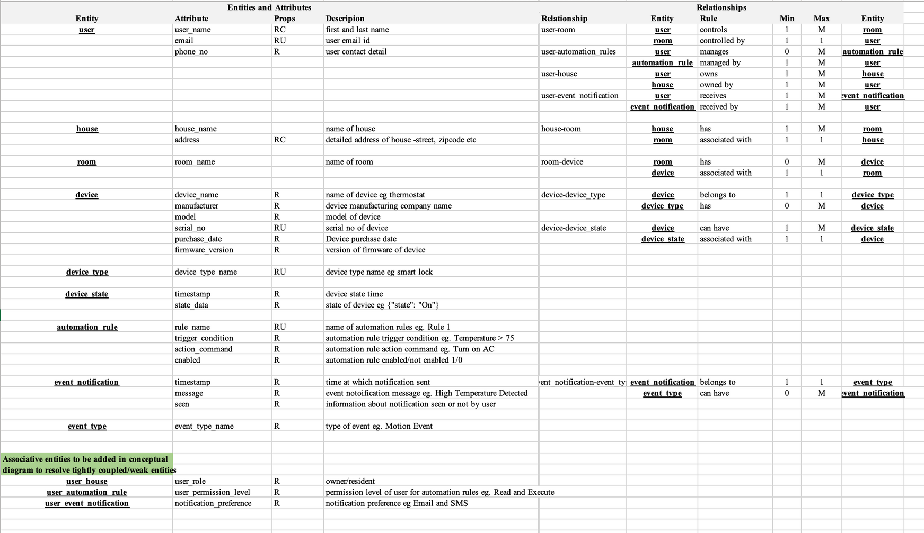
ERD DATA REQUIREMENTS

Slide 5
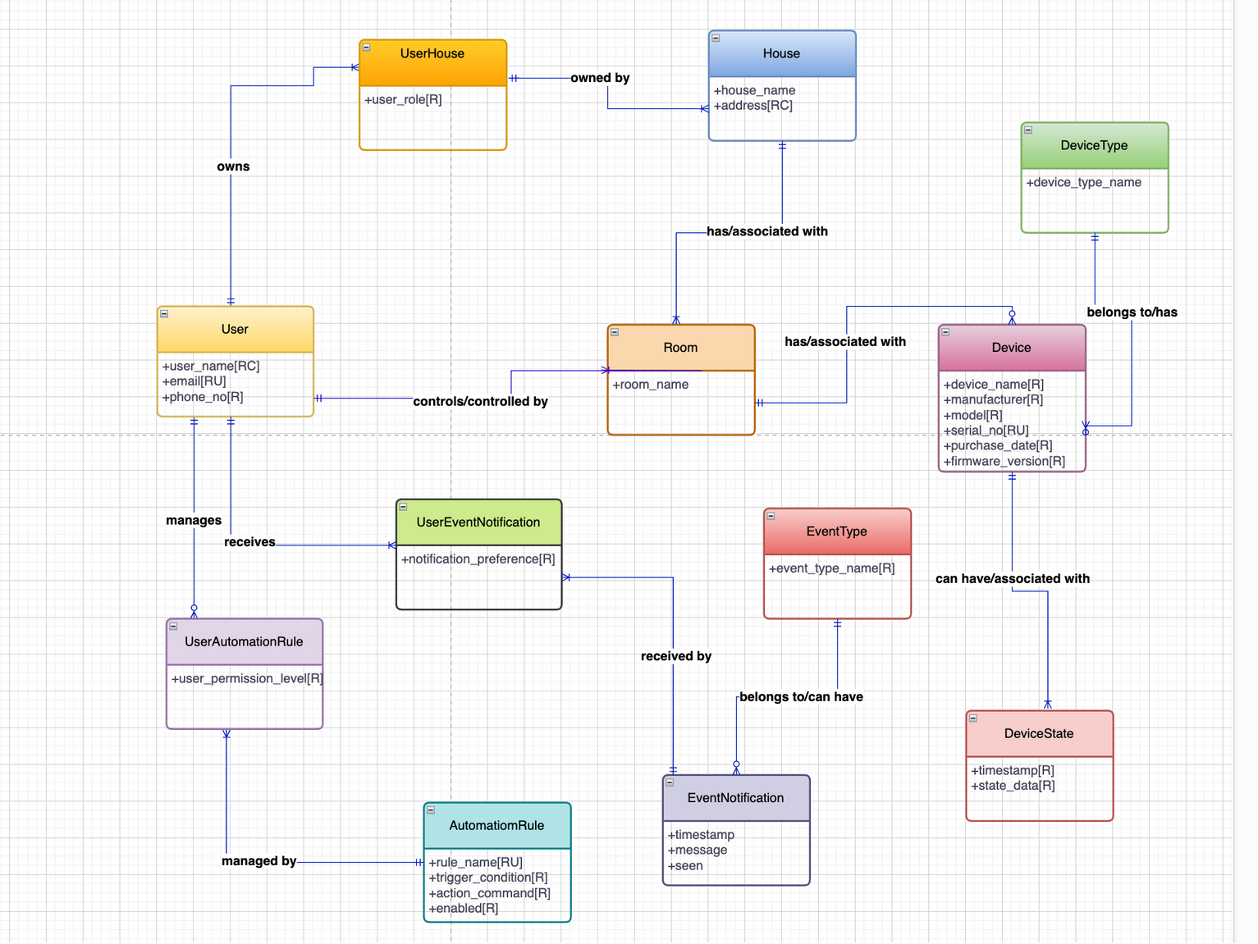
CONCEPTUAL MODEL

Slide 6
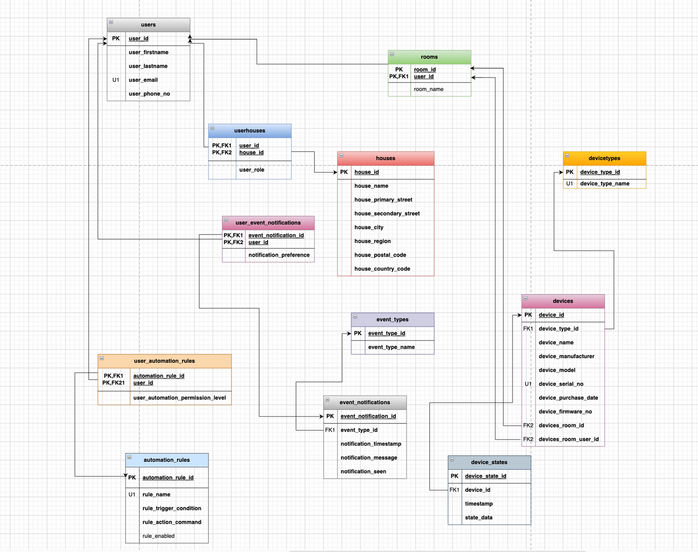
LOGICAL MODEL

Slide 7
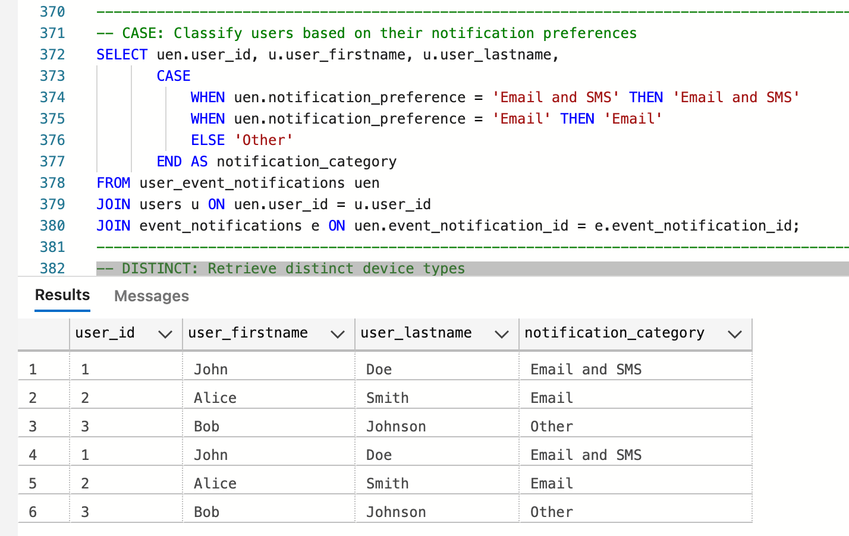
SQL SCENARIOS
1. Classify users based on their notification preference

Slide 8
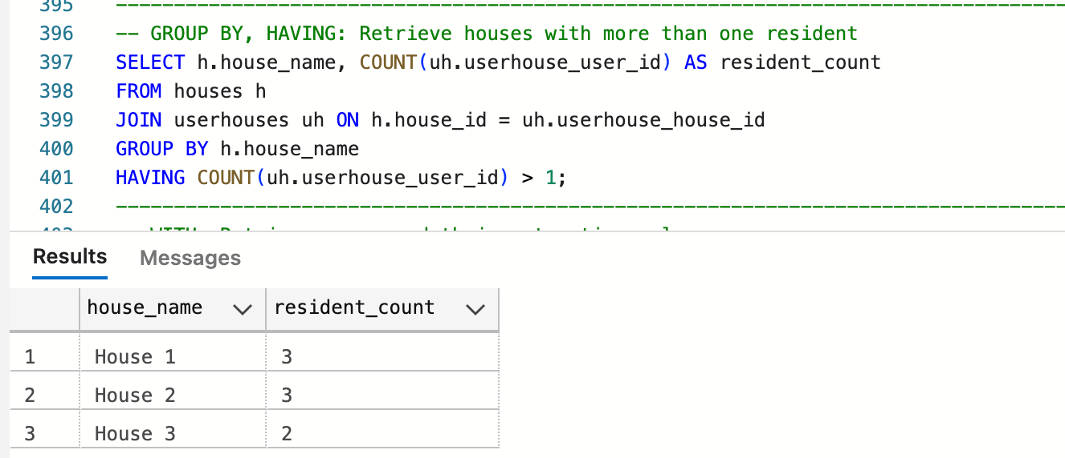
SQL SCENARIOS
2. Retrieve houses with more than one resident

Slide 9
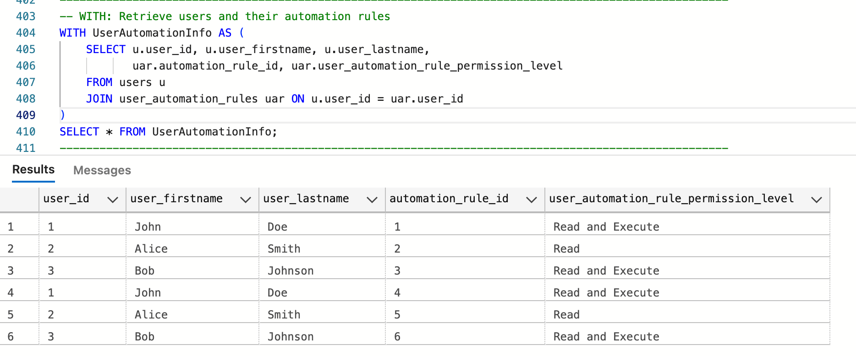
SQL SCENARIOS
3. Retrieve users and their automation rules

Slide 10
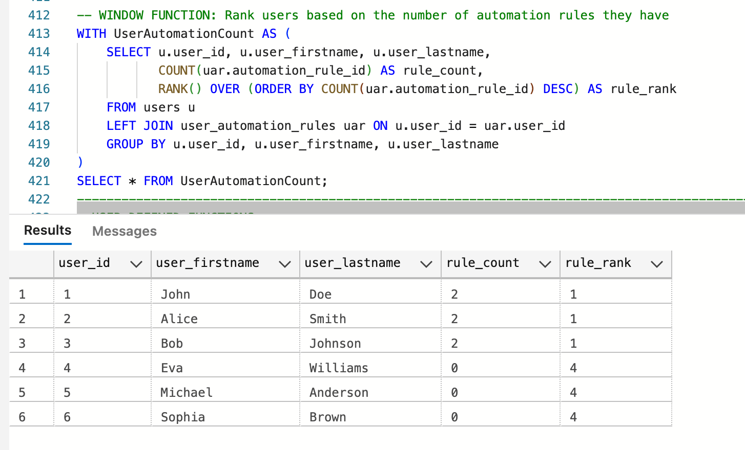
SQL SCENARIOS
4. Rank users based on the number of automation rules they have

Slide 11
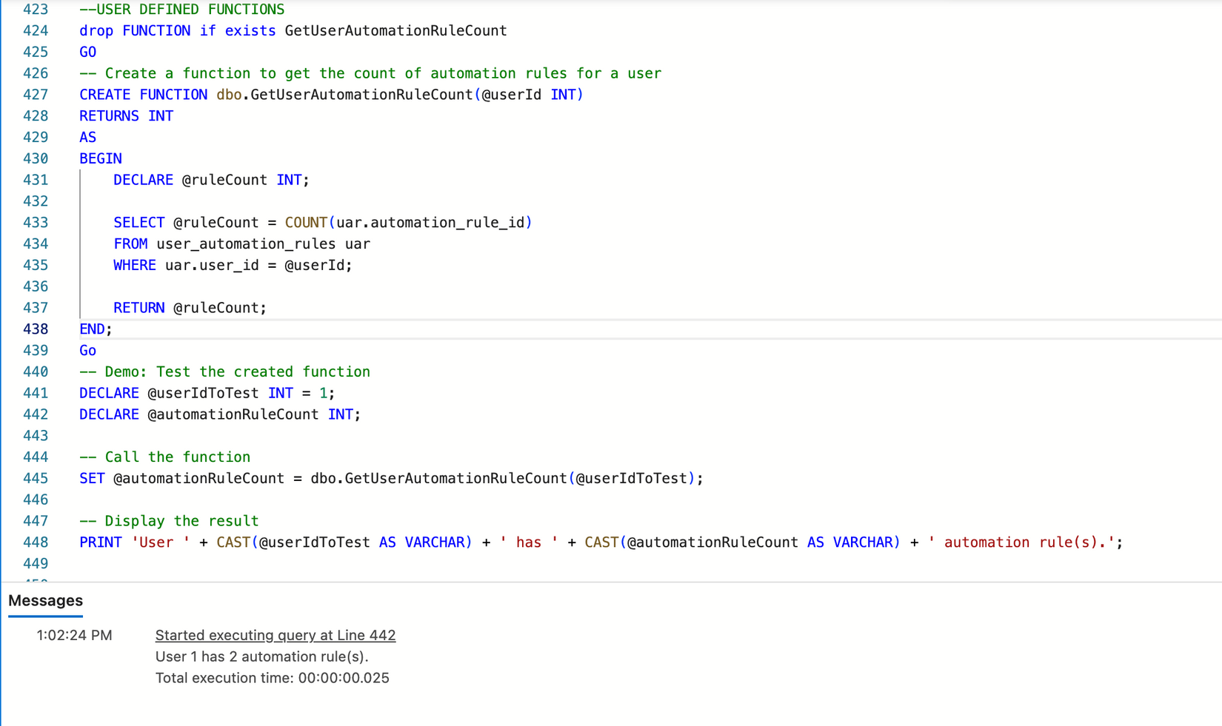
SQL SCENARIOS
5. Create a function to get the count of automation for a user

Slide 12
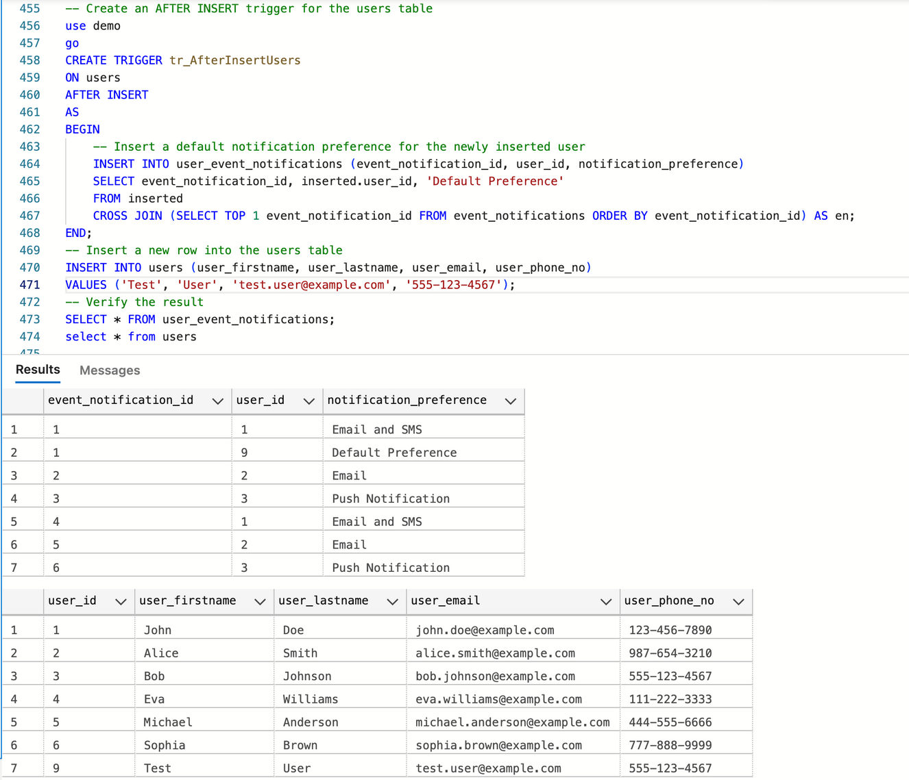
SQL SCENARIOS
6. Create an After Insert trigger for the users table

Slide 13
SQL SCENARIOS
7. Create an After Insert trigger for the users table

Slide 14
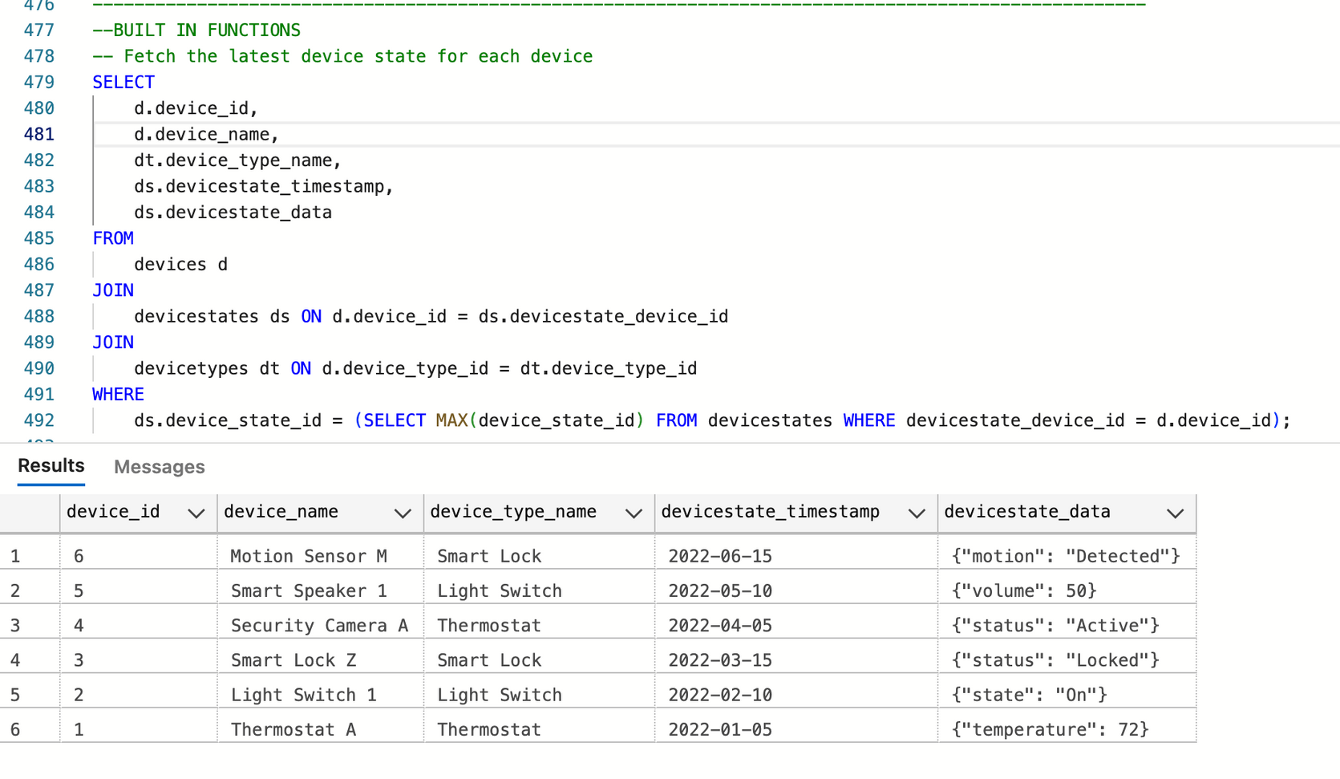
SQL SCENARIOS
8. Fetch the latest device state for each device

Slide 15
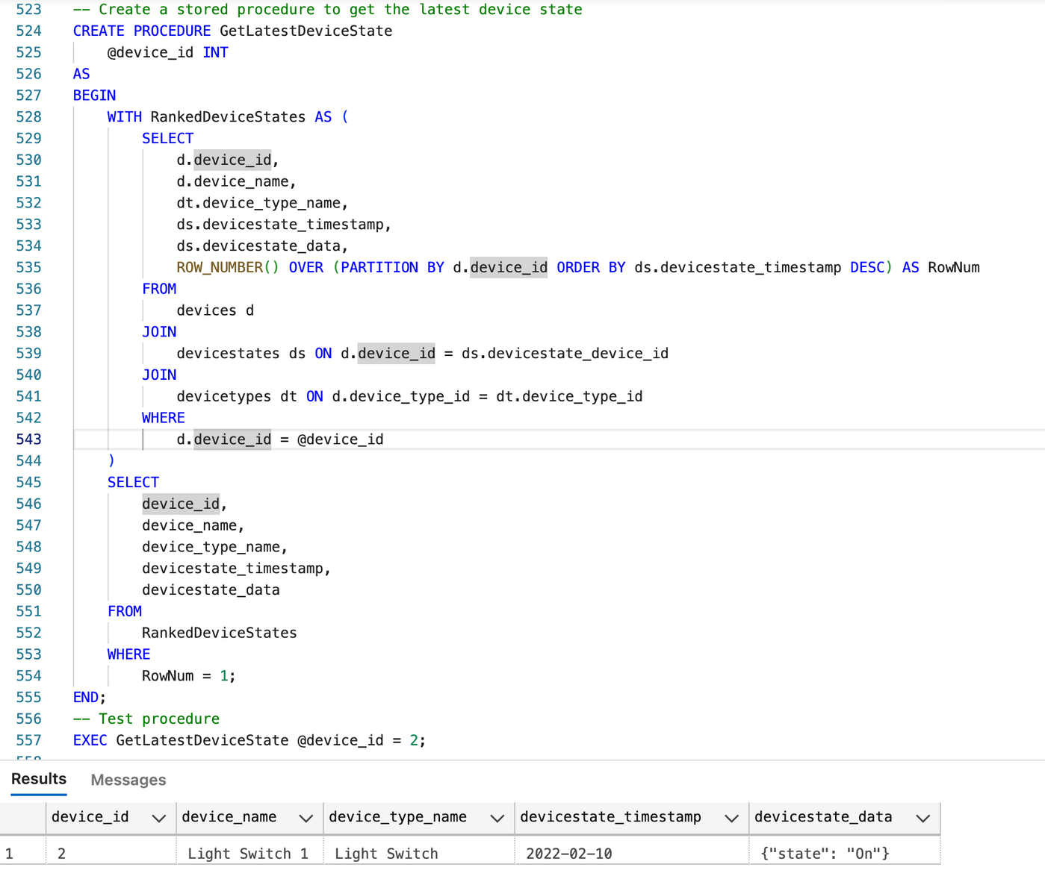
SQL SCENARIOS
9. Create a stored procedure to get the latest device state

Slide 16
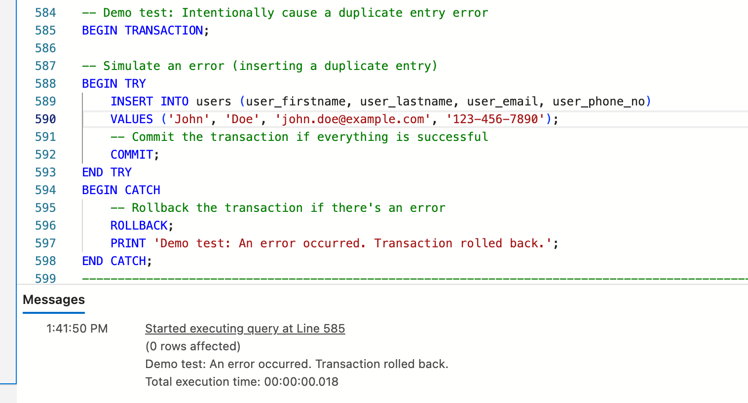
SQL SCENARIOS
10. Transaction: Result of a duplicate entry

Slide 17
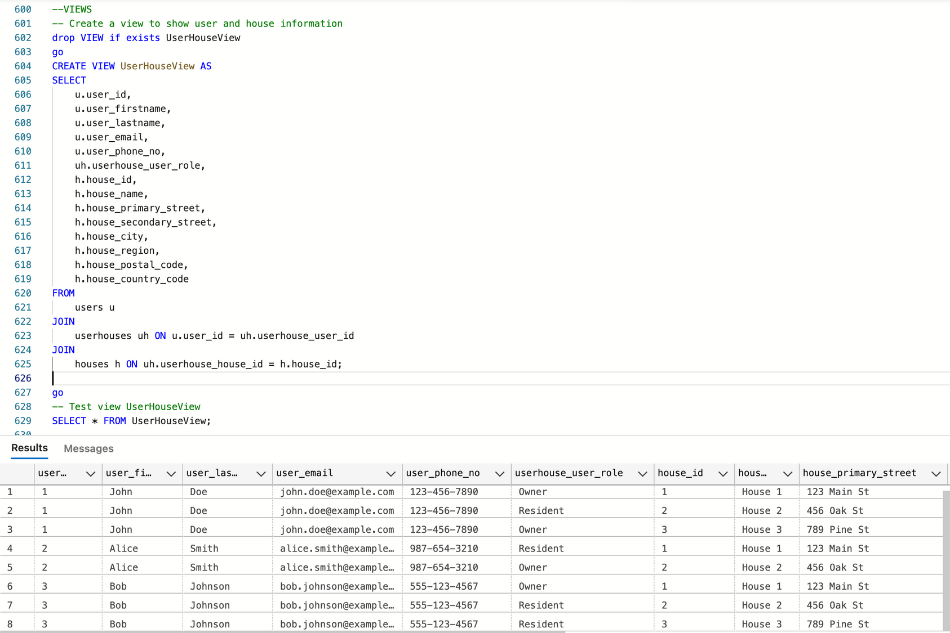
SQL SCENARIOS
11. Create a view to show user and house information

Slide 18
THANK YOU!!!

